Slide 2
Paper summary
XXX
Asks two related questions:
What are the employment effects of low-income wage subsides/tax-credits?
What are the wage effects of such a subsidy?
Uses a reform in France in 2015:
Decreased and increased marginal tax rates across the low-earner distribution.
Decreased participation tax rates across the low-earner distribution.
From a 10% reduction in the net of participation tax rate:
A 2.7% increase in hours worked.
A 3.1% decline in wages (31% pass through to firms).
Extensive margin response with no intensive margin response consistent with literature.

Slide 3
Approach and identification
XXX

Slide 4
Potential limitations: Interpretation of the shock variable
XXX
Two regions could have the same shock with two very different patterns of treatment.
e.g. Two regions with 10 people, A and B. In region A 10 people see net PTR fall by 1%, in region B 1 person sees it fall by 10%. Both regions have the same shock.
Furthermore, the simulated shocks are based on the change in tax incentives from their status quo.
Participation rate concern:
Take the individual who receives the largest hour-weighted treatment. On the substitution margin their MTR is unchanged, but the income effect will lower their work incentives.
Take an unemployed individual. On the substitution margin the MTR is lower, and there is no income effect.
However, this instrument would treat the former as treated and the later as untreated.
This is addressed by imputing their income based on characteristics to estimate a treatment intensity.

Slide 5
Potential limitations: Importance of randomly-assigned-shocks
XXX
Chaisemartin & Lei (2022): XXX

Slide 6
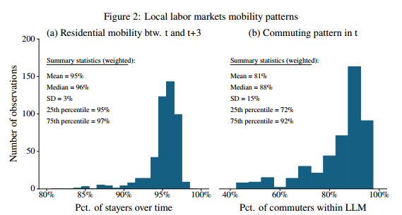
Potential limitations: Mobility
XXX
Mobility between regions shown to be limited over the period.
However, the key interest is mobility among treated individuals.

Slide 7
Minor questions
XXX
The imputation of wages for non-participants is done via OLS. Heckman selection model an alternative.
Equivalisation of earnings: No standard scale used, and unclear why equivalisation is needed.
Sensitivity to unbalanced panel.
General equilibrium effects (what happens to the level).
There is imperfect take-up, when prior policies had low or full take-up. These changes in treatment status may themselves be informative of behavioural responses.

Slide 8
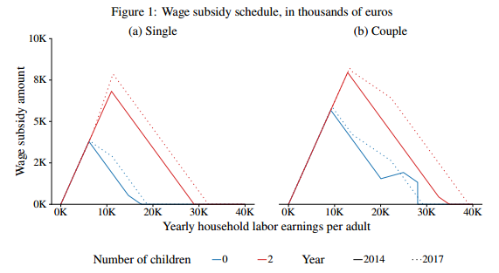
Extra Pictures
XXX

